Slide 1
Developing a Responsive and User-Friendly
Website using Latest Web Development
Tools
Harsh Joshi Mentor:
2019665 Mr. Ramesh Singh Rawat
CST SPL : 6

Slide 2
Problem Statement
The problem statement of this project is to
develop a responsive and userfriendly website
using latest web development tools.
“The approach taken consists of using HTML, CSS, and JavaScript to develop an online weather application.".

Slide 3
Introduction
Purpose : To provide users with real time weather information for their
current location or any search city.
Aim : (i) Provide Accurate Weather Information
(ii) Enhance User Experience
(iii) Promote Accessibility

Slide 4
Methodology
Requirements are gathered and analyzed inorder to add more suited functionalities.
A design based on the analyzed requirements is developed which helps in the implementation phase
Implementation of the design is started and is done in phases or parts inorder to get more better results.
Each unit is then combined with each other and is then deployed on the server.

Slide 5
User’s Role
The primary role of the user in this application is to :
View the current weather conditions of their location by granting location access.
Search for the weather information of any city using the search functionality.
Switch between "Your Weather" and "Search Weather" tabs to navigate between their local weather and searched city weather.

Slide 6
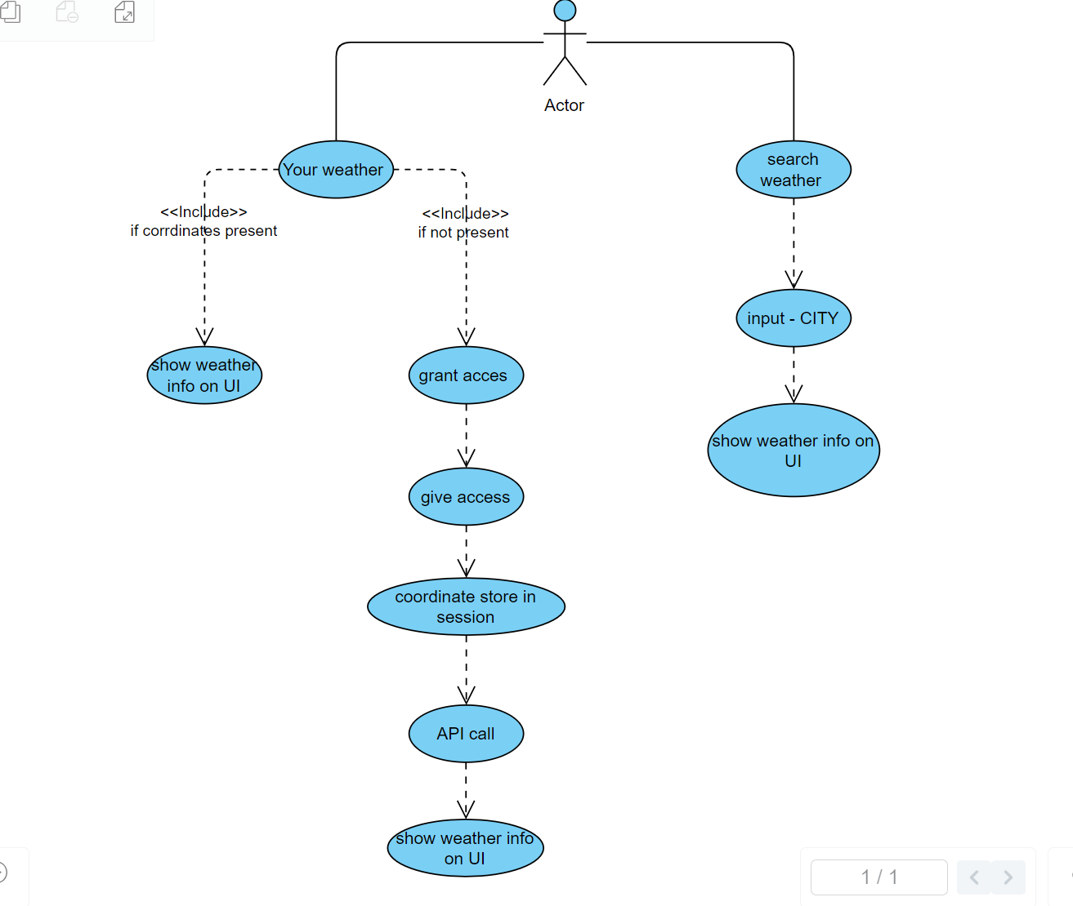
Flow of website

Slide 7
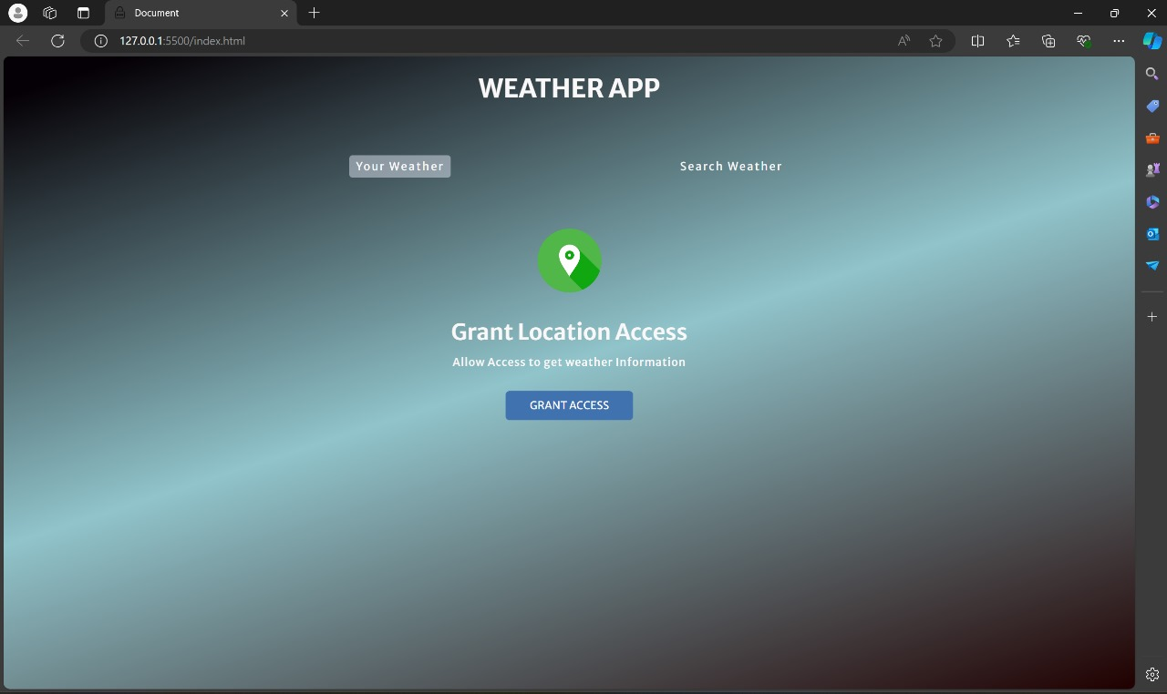
Result & Discussion
Home page

Slide 8
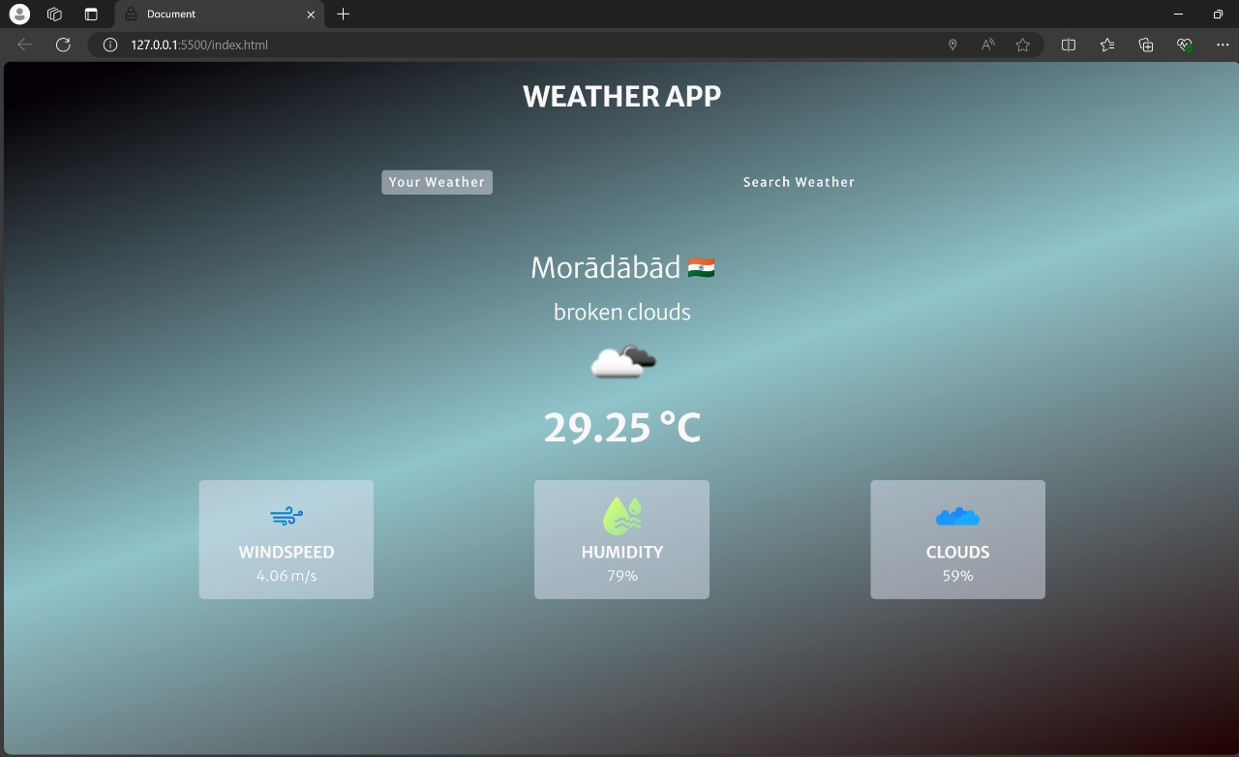
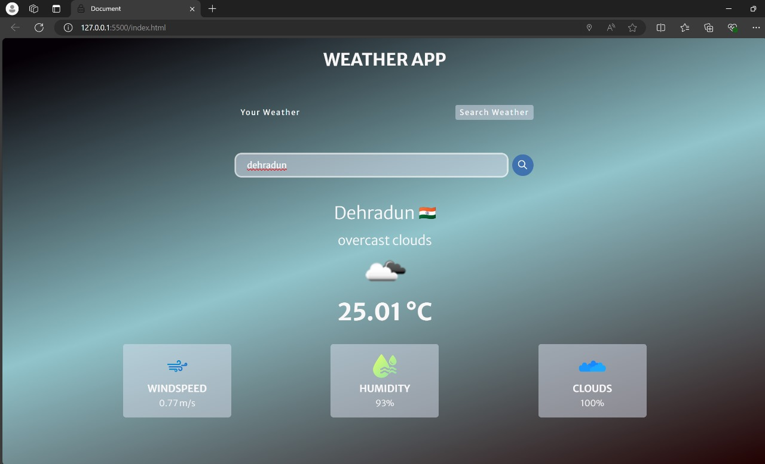
Current Location weather
We search weather for any location

Slide 9
Conclusion and Future Work
In conclusion, this weather application allows users to easily check the current weather for their location and search for weather in other cities. Built using HTML, CSS, and JavaScript, it provides real-time weather updates in a user-friendly way.
For future improvements, we can add :
(i) Weather Forecast: Include a 7-day weather forecast.
(ii) User Accounts: Allow users to create accounts and save their favourite locations.
(iii) Interactive Maps: Show weather conditions on maps.
(iv) Notifications: Send alerts for severe weather conditions.

